Slide 1


SEARCH ALGORITHMS APPLIED TO CITIZEN SAFETY AND HARRASMENT PREVENTION

Slide 2

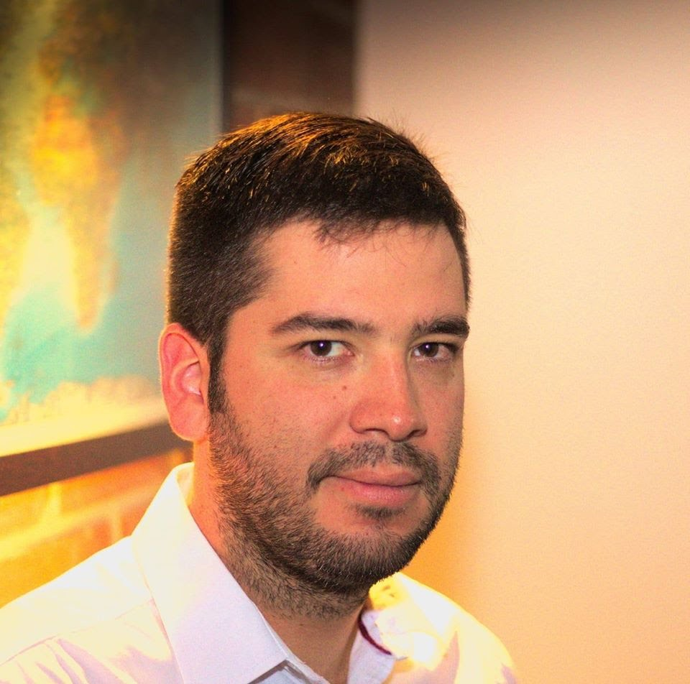
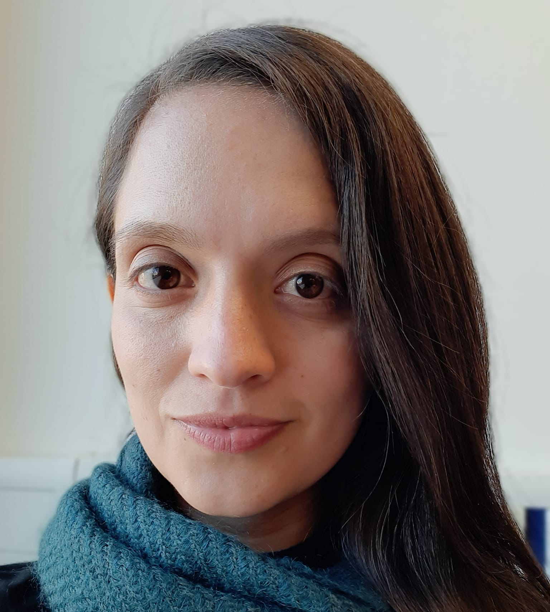

Presentation of the team
Julian Valencia
what have you done?
Marco Gomez what have you done?
Andrea Serna
Literature review
Mauricio Toro
Data preparation
https://github.com/julianvb03/ST0245-5001

